Slide 1
Popular Programming Tech
Part 10
Packages and Go Tools

Slide 2
Learning Objective
LO 2 : Apply GO programming language techniques and libraries
LO 3 : Solve problem using GO programming language

Slide 3
Outline
The Go test tool
Test functions
Coverage
Benchmark functions
Profiling
Example functions

Slide 4
The Go test tool
The go test subcommand is a test driver for Go packages that are organized according to certain conventions
In a package directory, files whose names end with _test.go are not part of the package ordinarily bui lt by go build but are a part of it when bui lt by go test.
Within *_test.go files, three kinds of functions are treated specially: tests, benchmarks, and examples

Slide 5
A test function, which is a function whose name begins with Test, exercises some program logic for correct behavior ; go test calls the test function and reports the result, which is either PASS or FAIL
A benchmark function has a name beginning with Benchmark and measures the performance of some operation; go test reports the mean execution time of the operation.
A example function, whose name starts with Example, provides machine-checked documentation

Slide 6


Test Function
Each test file must import the testing package. Test functions have the following sig nature:
Test function names must begin with Test; the option al suffix Name must begin with a capital letter:

Slide 7
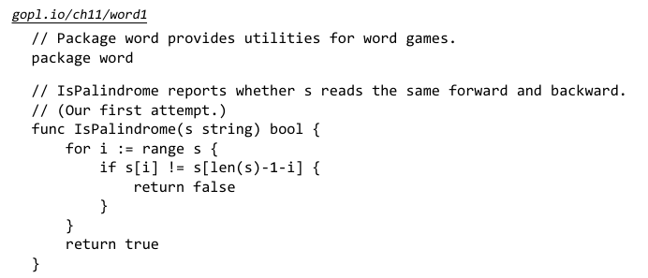

Slide 8
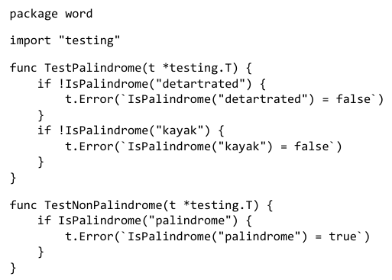

Slide 9

A go test (or go build) command with no package arguments operates on the package in the current directory. We can build and run the tests with the following command.

Slide 10
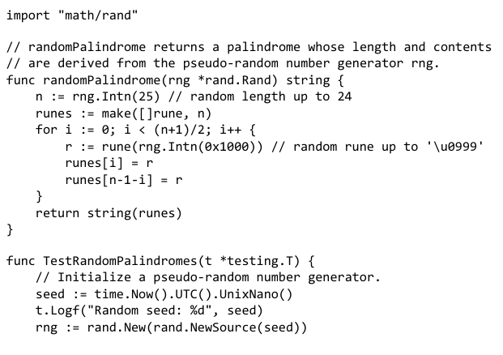
Randomized Testing
Table-driven tests are convenient for checking that a function works on inputs carefully selected to exercise interesting cases in the logic
Another approach, randomized testing, explores a broader range of inputs by constructing inputs at random

Slide 11
FINPRO Progres

Slide 12
References
https://go.dev/doc/install
Tutorial: Developing a RESTful API with Go and Gin - The Go Programming Language
https://go.dev/doc/tutorial/add-a-test

